Slide 1

DEPARTMENT OF COMPUTER SCIENCE AND ENGINEERING
SIGN LANGUAGE INTERPRETER FOR HEARING IMPAIRED
Submitted to:
Prof. Moussa Mahamat Boukar
Dean of Computing Sciences NILE UNIVERSITY OF NIGERIA
Submitted by: Guide:
Srihari M Dr. R. Anandan
Nagaprabhu N
Sanjai Ramasamy S A

Slide 2
Sign Language Interpreter for Hearing Impaired

Slide 3
Agenda
Objective and scope of the project
Basic concepts related to your project
Analysis and explanation of the identified Problem
Existing System
Proposed System
Screen Design in your IDE
Time plan of the project
Distribution of Work among Team members

Slide 4
Objective
To develop a Python-based program that converts the spoken language into sign language, which helps the deaf and difficulty in hearing people. Our program will use speech recognition to capture our spoken input and then it converts it into the corresponding sign language representation.

Slide 5
Scope
Speech Recognition: It is used to accurately transcribe the words spoken by the user into text.
Sign Language Conversion: Using the text transcribed using speech recognition, we will match it with the corresponding sign and display it.
User Interface: Our program has a user friendly interface which has minimal widgets in it and it is easy to used by everyone.

Slide 6
Global Overview of People with Hearing Impairment
According to WHO, over 430 million people globally are currently experience hearing loss.
And this is expected to be increased to 700 million by 2050 since the global population ages, and the factors like increased noise exposure and other environmental risks.

Slide 7
Estimated Number of people who are affected by hearing loss in key countries(2024)
Country | Estimated number of people in millions
United States | 37.5
India | 63
China | 27
European union | 60
Brazil | 10
Mexico | 3
United Kingdom | 12
Japan | 7
Australia | 3.6
Canada | 4
Nigeria | 3

Slide 8
Existing converters
SignAll: uses AI to convert speech into American Sign Language,
Google’s Project Relate: Mobile app which converts speech to text and is in experimental
phase to allow translation of text into sign language through Google’s translate app,
Hand Talk: Mobile app that converts Portuguese into Brazilian Sign Language.
Uses 3D models to display signs,
Sign Speak: converts speech into ASL and BSL(British Sign Language),
MotionGlove: Captures Hand movements and translate them into speech or text.

Slide 9
Complexity function of our code
Time Complexity:
O(n + m) for each recognition cycle, where n is the duration of the audio
and m is the length of the recognized text.
Space Complexity:
O(n + m) for each recognition cycle, where n is the size of the audio
and m is the length of the recognized text and corresponding images.

Slide 10
Basic Concepts Related to our project
Speech Recognition:
Converts spoken words into text using Natural Language Processing (NLP) techniques and algorithms.
Sign Language Representation:
The Sign language is represented using images which we have obtained from Kaggle.
Python Libraries and Tools
Speech Recognition: For capturing and transcribing speech.
Tkinter: For Graphical User Interface (GUIs).
Speech Recognition
Sign Language Representation
Python Libraries and Tools

Slide 11
Analysis and Explanation of Identified Problem
Problem Statement: Individuals with hearing impairment often faces challenges in communication when interacting with those who don’t know sign language. The older methods were using a manual translator or some complex setups.
Since finding a manual translator at all times is difficult we propose our system which can be accessible at all times. It can be used for real time conversion.

Slide 12
Existing System
Current Methods:
Manual Interpretation: Right now people might require a human interpreter who knows sign language.
Text-Based Translation: Converts speech to text, which is then translated to sign language by a human or static system.
Limitations:
Manual methods are not scalable.
User may find the text-based solutions less engaging and interactive.

Slide 13
Proposed System
Current Methods:
Speech Recognition module,
Text-to-sign language module,
User Interface.
Features:
These are easily accessible to everyone.
Processes and translates speech into sign language instantly.

Slide 14
Screen Design
In our IDE

Slide 15
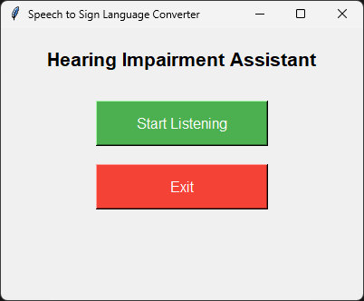

Slide 16
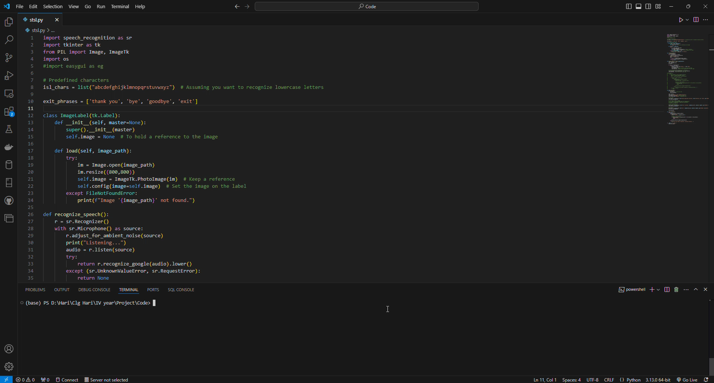

Slide 17
Time Plan
Week 1-2
Planning
Week 3-6
Development
Week 7
Presenting our Project
Planning – Defining our project requirements and scope and research for existing solutions and tools.
Development – Implementing the speech recognition & text to sign-language conversion.

Slide 18
Work Distribution
Speech Recognition and text conversion – Srihari.
Transcribed text to Sign language – Nagaprabhu.
User Interface using Tkinter – Sanjai Ramasamy.

Slide 19
Thank You

